Slide 1
Power system fault detection and classification
CAPSTONE PROJECT
PRESENTED BY:
KALYANI REDDY NALLA–CMR INSTITUTE OF TECHNOLOGY-ARTIFICIAL INTELLIGENCE AND MACHINE LEARNING

Slide 2
OUTLINE
Problem Statement (Should not include solution)
Proposed System/Solution
System Development Approach (Technology Used)
Algorithm & Deployment
Result (Output Image)
Conclusion
Future Scope
References

Slide 3
Problem Statement
Example: Currently, maintaining the reliability of power distribution systems is critical for urban infrastructure. Unexpected faults such as line-to-ground, line-to-line, or three-phase faults can severely impact the stability of the power grid. It is important to detect and classify these faults rapidly and accurately to minimize power outages and ensure quick maintenance response. Eventually, enabling real-time fault classification helps utilities improve operational efficiency and reduce downtime. The crucial part is the prediction and classification of fault types using electrical parameters like voltage and current phasors to automate fault identification and response.

Slide 4
Proposed Solution
The proposed system aims to detect and classify power faults in a distribution network to enhance grid stability and ensure faster restoration. Using electrical data and machine learning, the solution identifies fault types accurately and efficiently.
Data Collection:
Collect historical data on voltage, current, power load, weather, maintenance status, and component health.
Include labeled fault types (e.g., Line Breakage, Transformer Failure).
Data Preprocessing:
Clean the dataset and handle missing values.
Perform feature engineering and encode categorical variables.
Machine Learning Algorithm:
Use classification models (e.g., Random Forest, XGBoost) to predict fault types.
Train on historical patterns using electrical and environmental data.
Deployment:
Build a simple dashboard or app to display predictions.
Deploy using IBM Cloud Lite with Watson Machine Learning services.
Evaluation:
Evaluate using Accuracy, Precision, Recall, and F1-score.
Improve with regular updates and feedback-based tuning.

Slide 5
System Approach
The "System Approach" section outlines the overall strategy and methodology for developing and implementing the power system fault detection and classification model.
System Requirements
A machine with minimum 8 GB RAM, i5/i7 processor, and 64-bit OS.
Stable internet connection to access and deploy services via IBM Cloud Lite.
Python environment (preferably via Jupyter Notebook or Google Colab for development).
IBM Cloud account with access to:
IBM Watson Machine Learning
IBM Cloud Object Storage
Required Libraries:
pandas, NumPy, scikit-learn – data handling and ML
matplotlib, seaborn – visualization
xgboost, imbalanced-learn – advanced modeling
ibm- Watson - machine-learning – IBM Cloud deployment

Slide 6
Algorithm & Deployment
Algorithm Selection: Random Forest is selected for its high accuracy and ability to handle mixed feature types for fault classification.
Data Input: Voltage, Current, Power Load, Temperature, Wind Speed, Weather, Maintenance Status, Component Health.
Training Process: Data is preprocessed and split into training/testing sets. Cross-validation and GridSearchCV are used to optimize performance.
Prediction Process: The trained model predicts the type of power fault using new input data and can be deployed for real-time classification via IBM Cloud.

Slide 7
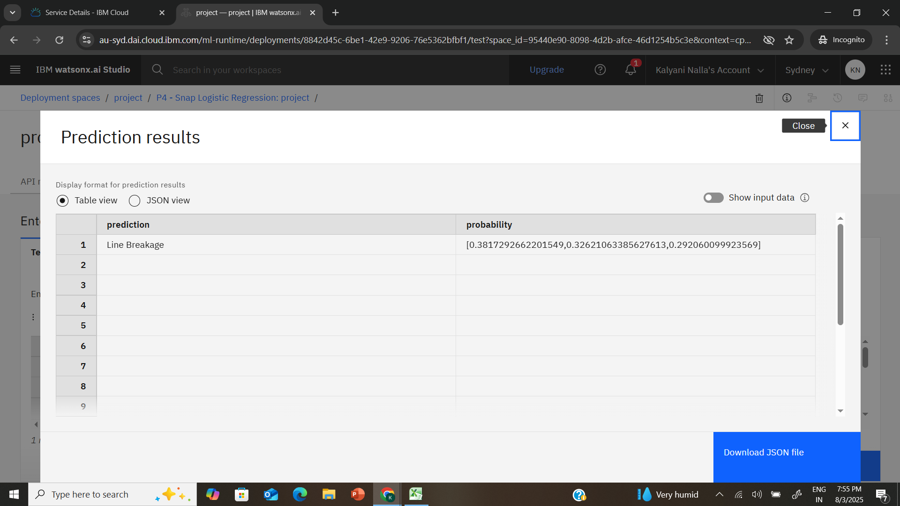
Result

Slide 8
Conclusion
Summarize the findings and discuss the effectiveness of the proposed solution. Highlight any challenges encountered during the implementation and potential improvements. Emphasize the importance of accurate bike count predictions for ensuring a stable supply of rental bikes in urban areas.

Slide 9
Future scope
Discuss potential enhancements and expansions for the system. This could include incorporating additional data sources, optimizing the algorithm for better performance, and expanding the system to cover multiple cities or regions. Consider the integration of emerging technologies such as edge computing or advanced machine learning techniques.

Slide 10
References
List and cite relevant sources, research papers, and articles that were instrumental in developing the proposed solution. This could include academic papers on bike demand prediction, machine learning algorithms, and best practices in data preprocessing and model evaluation.

Slide 11
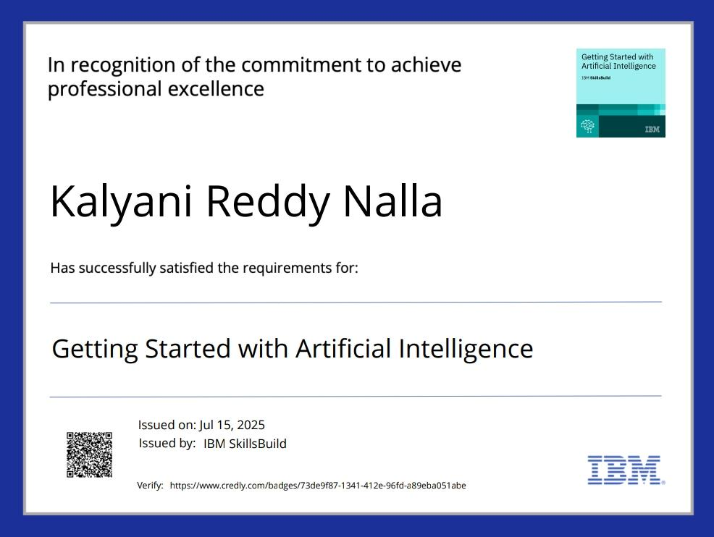
IBM Certifications

Slide 12
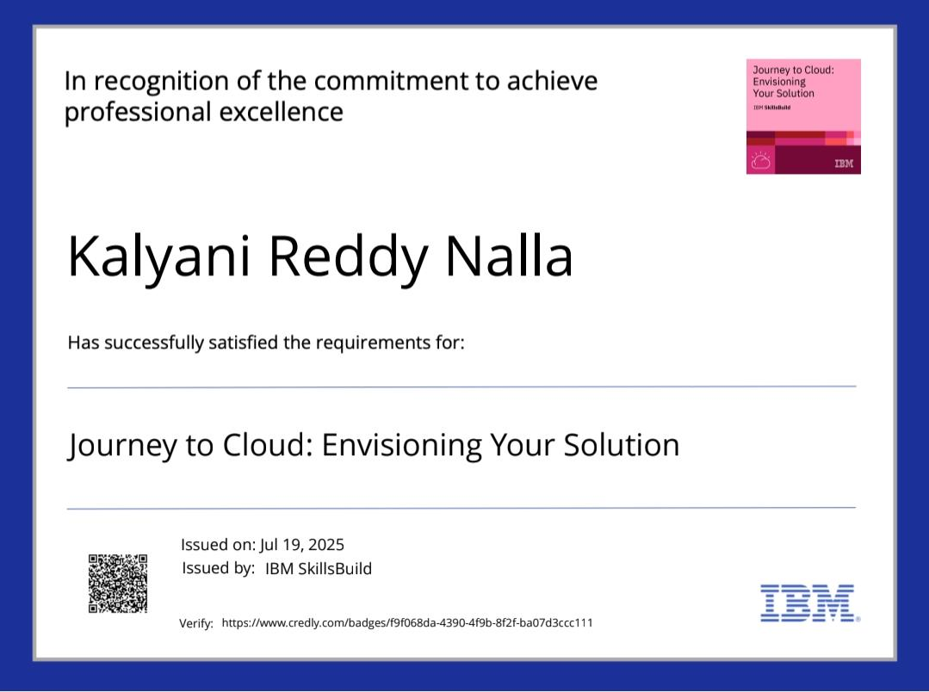
IBM Certifications

Slide 13
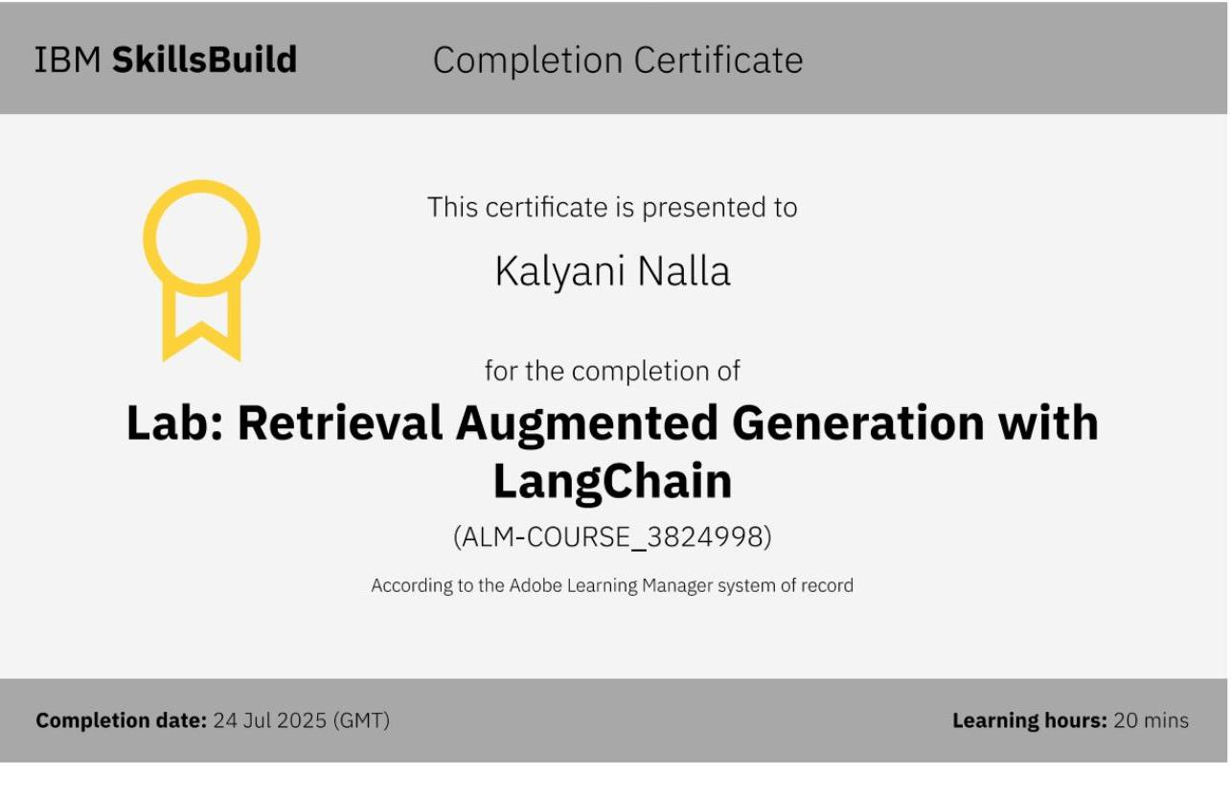
IBM Certifications

Slide 14
THANK YOU

